Slide 1
General Guidelines for Presentation
Slides should not be too heavy with content. Better to create point wise.
If you require more than one slide for any point, right click on that point slide then select duplicate slide and modify the duplicated slide.
Diagrams must be aligned at centre and clearly visible with caption.
All the mentioned fonts, font size, title content, etc should not change and strictly as per the given format and guidelines.

Slide 2

Placement Hub
Group members with Student Id
Pushkaraj Narkhede(24107077)
Nimish Bhoir(24107010)
Harsh Patil(24107070)
Prem Patil(24107132)
Project Guide
Mrs. Richa Singh

Slide 3
Contents
Introduction
Objectives
Scope
Features / Functionality
Project Outcomes
Technology Stack
Block Diagram if applicable

Slide 4

SDG 8: Decent Work and Economic Growth - Promote sustained, inclusive, and sustainable economic growth, full and productive employment, and decent work for all.

Slide 5
1. Introduction
Problem Identified :
Students face difficulty tracking placement opportunities from different companies.
Placement information is often scattered across emails, notices, or WhatsApp groups.
Solution Proposed :
Develop a Placement Portal App for students and placement co-ordinators.
Provide a centralized platform to view job postings, apply for companies, and track placement status.

Slide 6
2. Objectives
To develop a centralized platform for managing placement information.
To provide students with real-time updates about job opportunities.
To simplify the process of applying for campus placements.
To help placement coordinators manage company drives efficiently.
To build a user-friendly mobile application for students.

Slide 7
3. Scope
Can be used by college placement cells to manage recruitment activities.
Can help students easily access job opportunities and apply online.
Can allow companies to post job openings and view eligible candidates.
Can reduce manual work in the placement process.
Can be extended for multiple colleges or universities in the future.

Slide 8
4. Feature /Functionality
Feature 1: Student Registration & Login
Students can create accounts and securely log in to the portal.
Feature 2: Job/Company Listings
Students can view available companies, job roles, eligibility criteria, and
Deadlines
Feature 3: Apply for Placement Drives
Students can apply for companies directly through the application.

Slide 9
Feature 4: Admin Panel
Placement cell can add companies, manage job postings, and monitor
student applications.
Feature 5: Notifications
Students receive notifications about new placement drives and updates.

Slide 10
5. Outcome of Project
Students can register and log in to the application.
Students can view available companies and job roles.
Students can apply for placement drives online.
Admin can add or manage company job postings.
Admin can view student applications and eligibility.
Students receive placement notifications and updates.

Slide 11
6. Technology Stack
Frontend • Frameworks/Libraries: React.js, HTML5, CSS3, JavaScript/TypeScript
• UI/UX Tools: Responsive design, Kanban-style boards for recruiters, dashboards for colleges by Antigravity
• Authentication: Secure login/signup flows with JWT or OAuth • Database: PostgreSQL or Supabase

Slide 12
6. Technology Stack
2. Backend (Server-Side)
• Frameworks: Node.js with Express.js (likely, given Lovable’s ecosystem)
• APIs: RESTful APIs for job postings, student profiles, and analytics
• Business Logic: Handles resume parsing, smart matching, and placement workflows
3.Database And Storage:
• Database : postgre SQL or MongoDB
• Storage : Cloud storage for resumes and documents

Slide 13
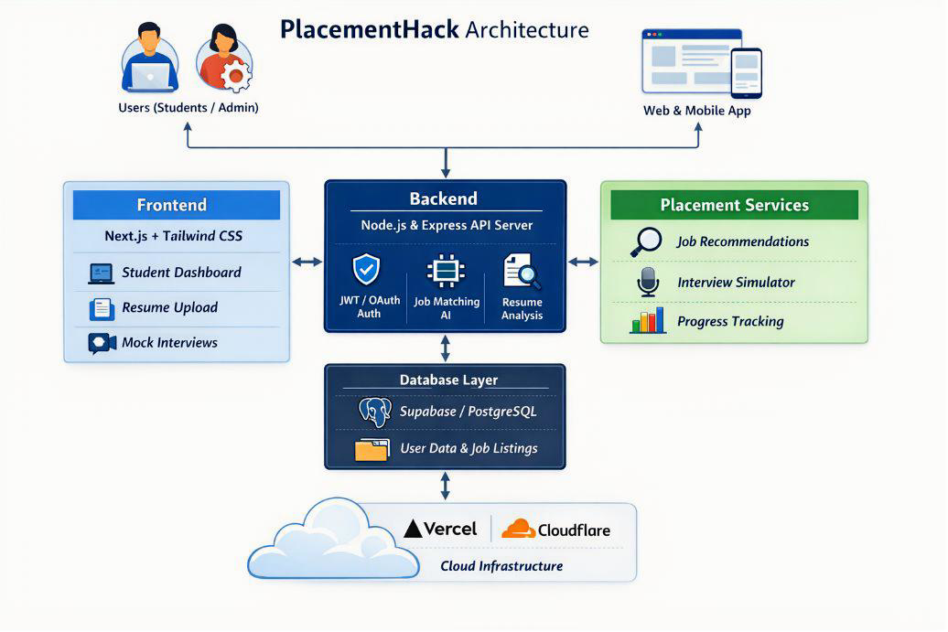
7. Block Diagram ( if applicable)

Slide 14
Thank You

